Slide 1
FUNDAMENTALS OF SQL PROGRAMING PROJECT PHASE - 2
Shirmila Hewapathirana (Student)
Ms Maryam Kazemi (Professor)
METRO COLLEGE OF TECHNOLOGY
2024/25

Slide 2
PROJECT SUMMARY
Data sample:
Bank data (Checking, Savings, Business. Students and Visitor accounts)
Total number of Tables
17 tables
Development Method
Tables : T-SQL method
Database Diagram : GUI
Process Followed
Creating tables with primary key
Creating tables with primary keys and Foreign keys
Creating Database Diagram
Coding work

Slide 3
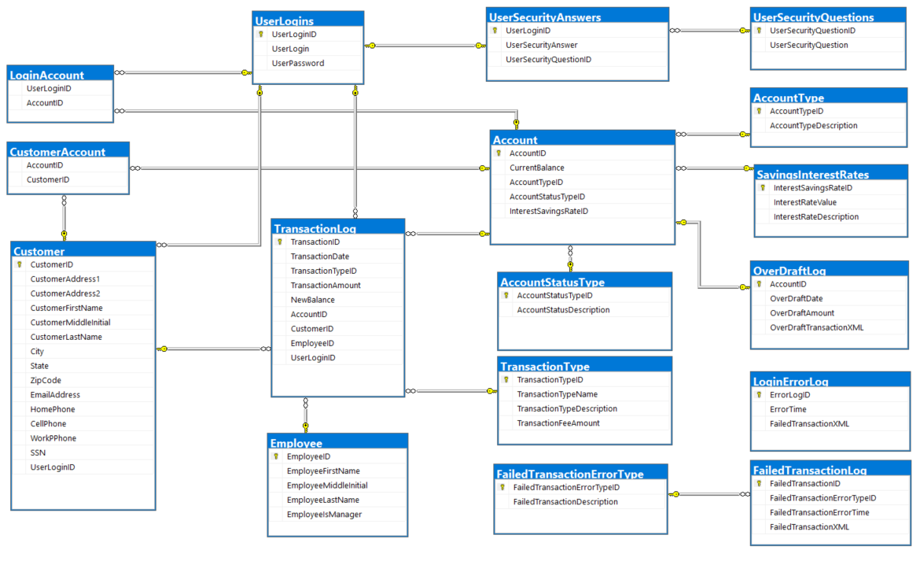
DATABASE DIAGRAM

Slide 4
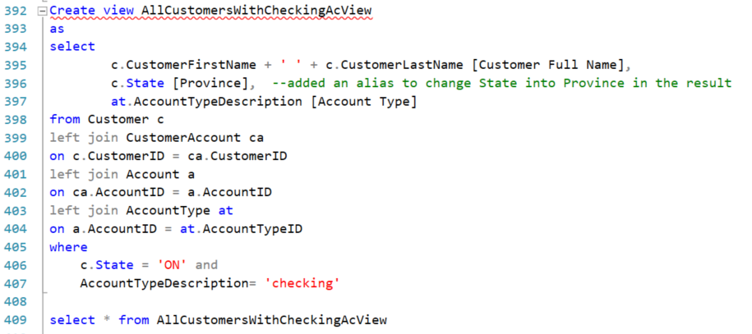

Q1.
Create a view to get all customers with checking accounts from ON province.

Slide 5
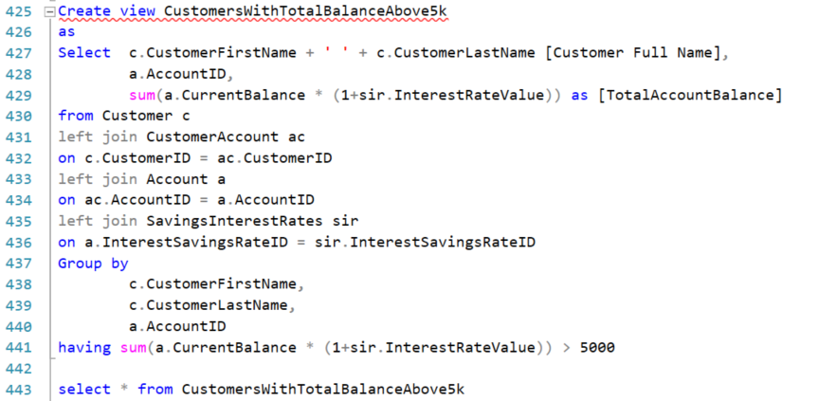

Q2.
Create a view to get all customers with a total account balance (including interest rate) greater than 5000.

Slide 6
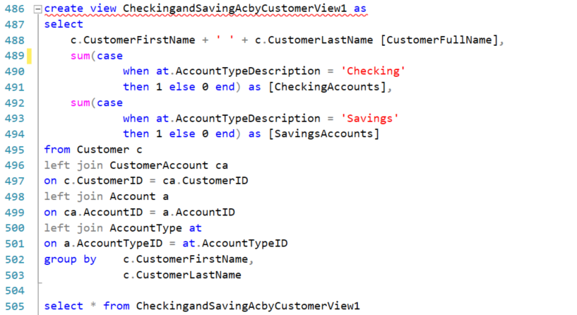
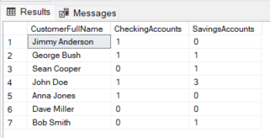
Q3.
Create a view to get counts of checking and savings accounts by customer.

Slide 7
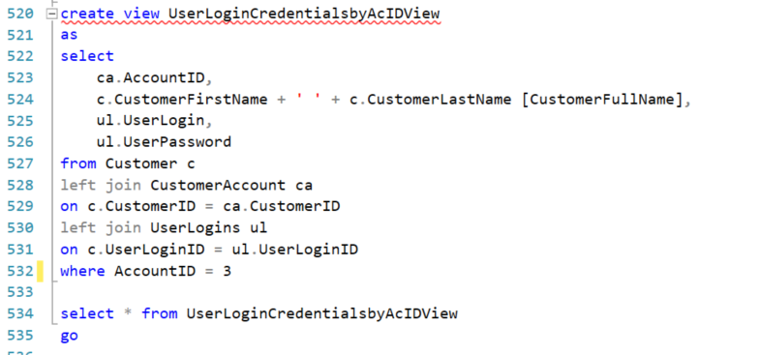

Q4.
Create a view to get any particular user’s login and password using AccountId.

Slide 8
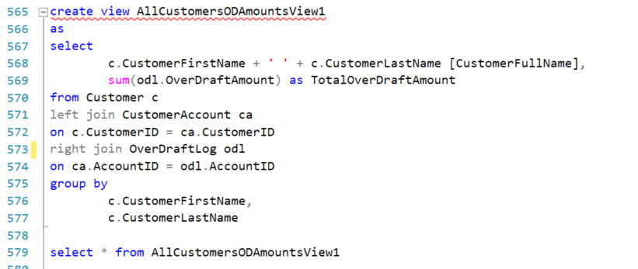
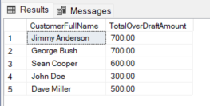
Q5.
Create a view to get all customers’ overdraft amounts.

Slide 9
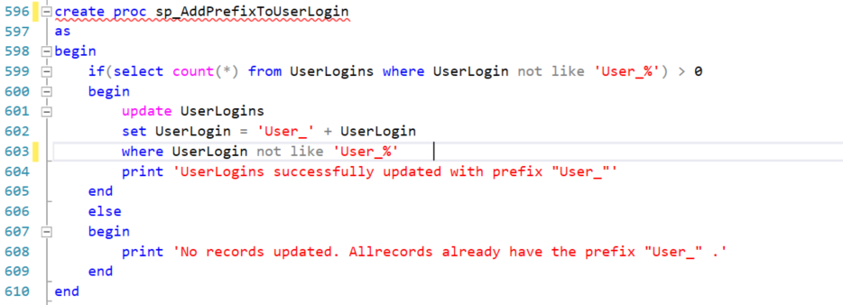
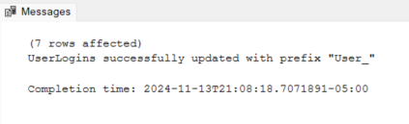

Q6.
Create a stored procedure to add “User_” as a prefix to everyone’s login (username)

Slide 10
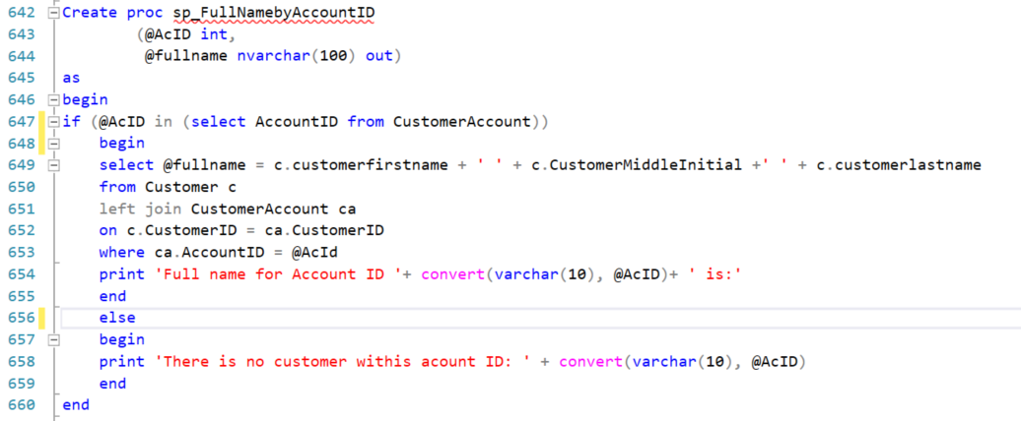
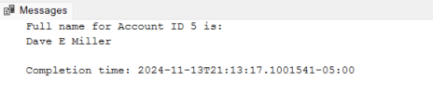


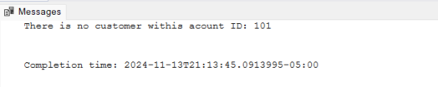
Q7.
Create a stored procedure that accepts AccountId as a parameter and returns the customer’s full name.

Slide 11
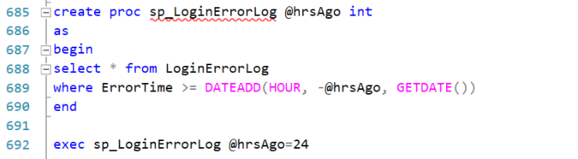
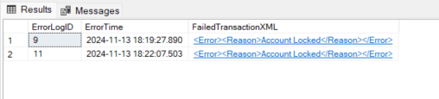
Q8.
Create a stored procedure that returns error logs inserted in the last 24 hours.

Slide 12
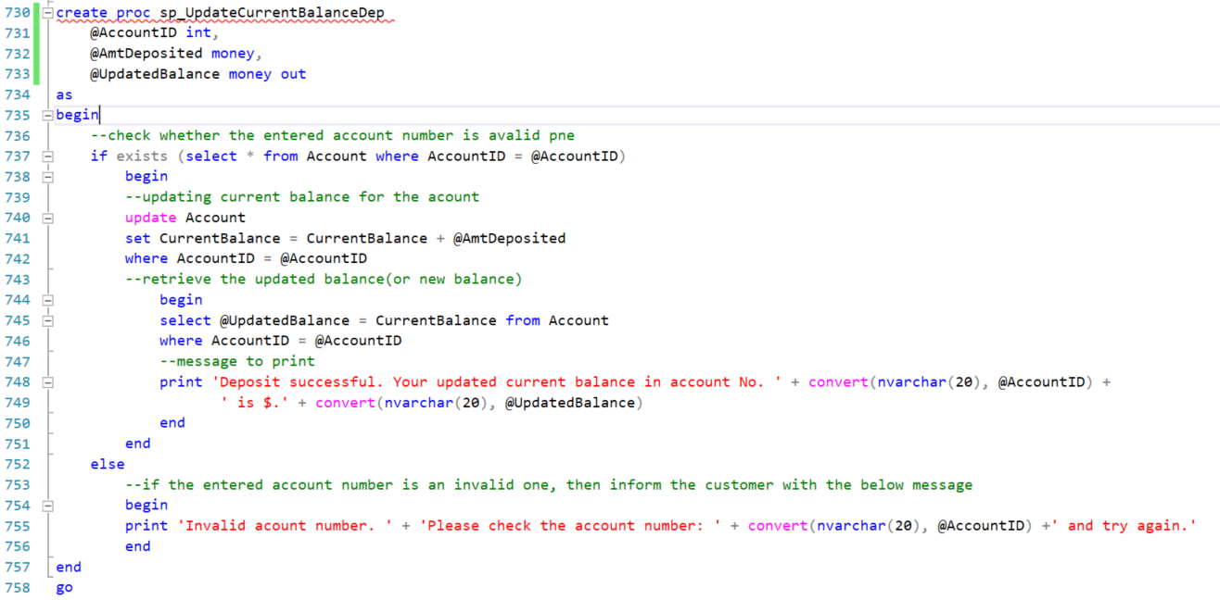
Q9.
Create a stored procedure that takes a deposit as a parameter and updates the CurrentBalance value for that particular account.

Slide 13
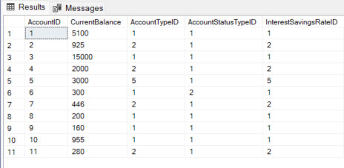

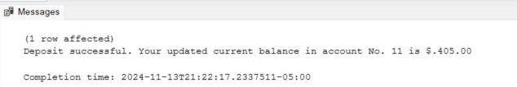

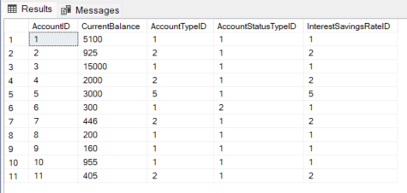

Q9.
-/Contid

Slide 14
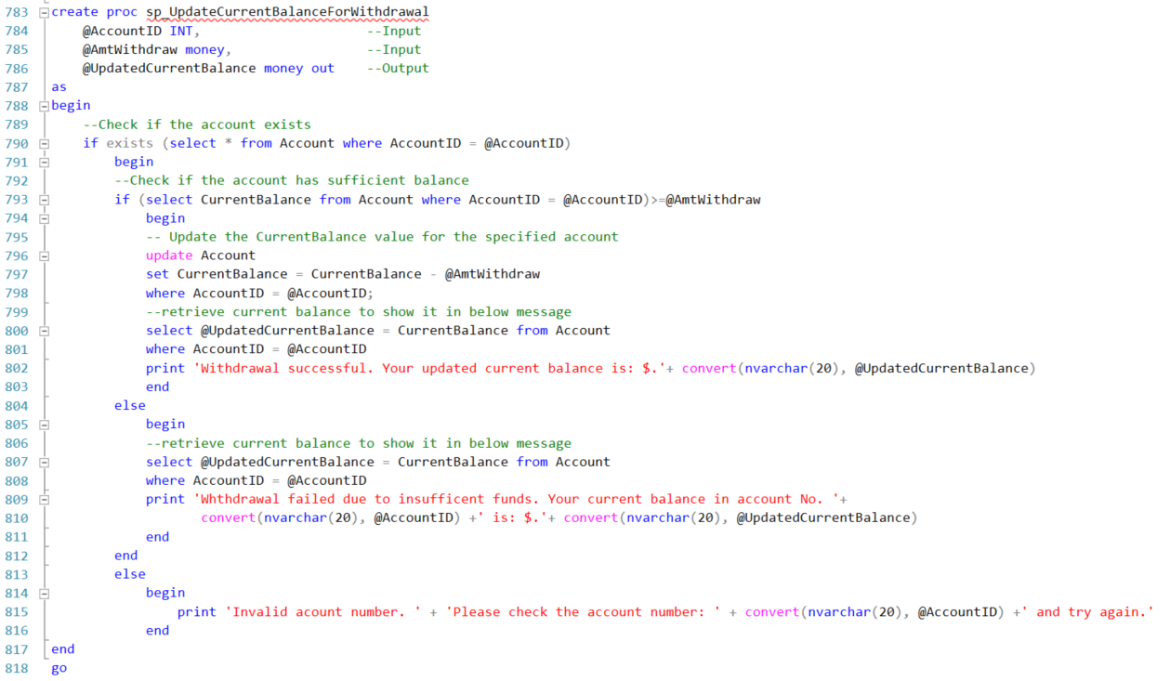
Q10.
Create a stored procedure that takes a withdrawal amount as a parameter and updates

Slide 15

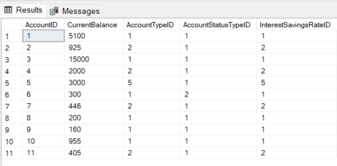
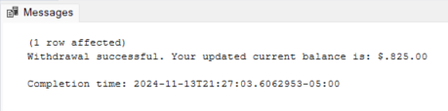


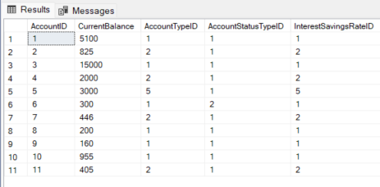

Q10.
-/Contid

Slide 16
THANK YOU !

Slide 17
BACKUP

Slide 18
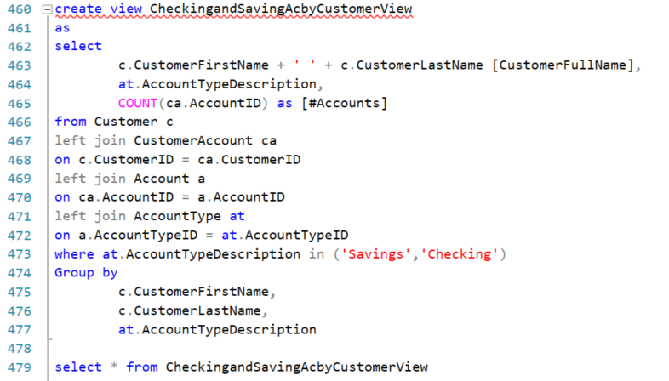
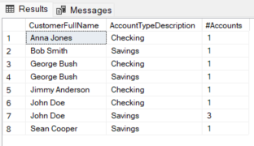
Q3.
Create a view to get counts of checking and savings accounts by customer.
BACKUP

Slide 19
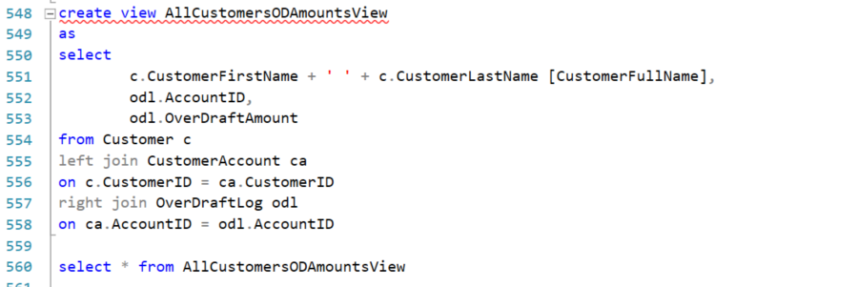
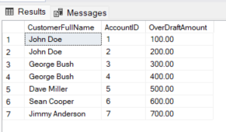
Q5.
Create a view to get all customers’ overdraft amounts.
BACKUP

